Slide 1
Intro to ML
The Hello World of Machine Learning

Slide 2
What is Learning ?

Slide 3
What is Learning ?
The acquisition of knowledge or skills through study, experience, or being taught.
Oxford dictionary

Slide 4
What is Learning ?
The acquisition of knowledge or skills through study, experience, or being taught.
Oxford dictionary
Understand what’s going on with different methods and use this information the next time.
My interpretation

Slide 5
How do we learn ?

Slide 6
How do we learn ?
Get instructions from others

Slide 7
How do we learn ?
Get instructions from others
Interpret a situation and try to define rules or draw conclusions alone

Slide 8
How do we learn ?
Get instructions from others
Interpret a situation and try to define rules or draw conclusions alone
Learn from previous mistakes or success

Slide 9
How do Machines learn ?

Slide 10
How do Machines learn ?
Get instructions from others
Interpret a situation and try to define rules or draw conclusions alone
Learn from previous mistakes or success

Slide 11
How do Machines learn ?
Get instructions from others
→ supervised learning
Interpret a situation and try to define rules or draw conclusions alone
Learn from previous mistakes or success

Slide 12
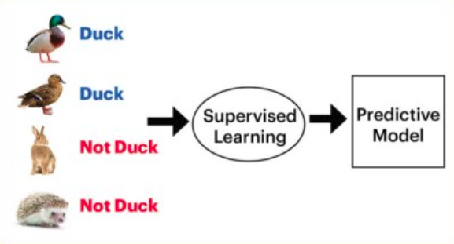
Supervised
https://medium.com/datadriveninvestor/differences-between-ai-and-machine-learning-and-why-it-matters-1255b182fc6

Slide 13
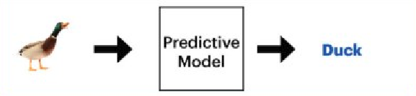
Supervised
https://medium.com/datadriveninvestor/differences-between-ai-and-machine-learning-and-why-it-matters-1255b182fc6

Slide 14
How do Machines learn ?
Get instructions from others
→ supervised learning
Interpret a situation and try to define rules or draw conclusions alone
→ unsupervised learning
Learn from previous mistakes or success

Slide 15
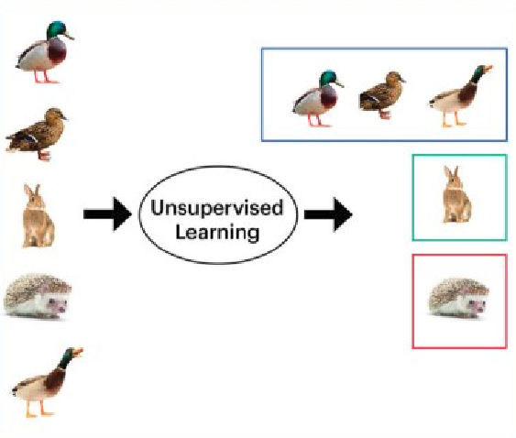
Unsupervised
https://medium.com/datadriveninvestor/differences-between-ai-and-machine-learning-and-why-it-matters-1255b182fc6

Slide 16
How do Machines learn ?
Get instructions from others
→ supervised learning
Interpret a situation and try to define rules or draw conclusions alone
→ unsupervised learning
Learn from previous mistakes or success
→ reinforcement learning

Slide 17
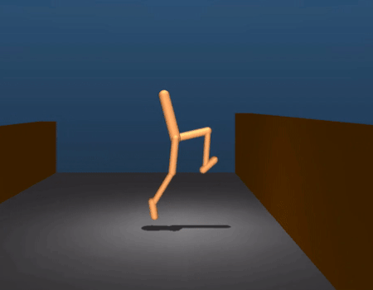
Reinforcement
https://www.theverge.com/tldr/2017/7/10/15946542/deepmind-parkour-agent-reinforcement-learning

Slide 18
So, what will we do?

Slide 19
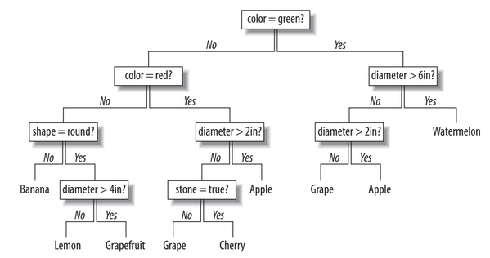
So, what will we do? - Learn with decision trees
https://github.com/ShawnLeee/the-book/blob/master/pybooks/Programming%20Collective%20Intelligence.pdf

Slide 20
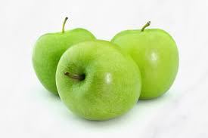
So, what will we do? - Learn with decision trees
?
https://github.com/ShawnLeee/the-book/blob/master/pybooks/Programming%20Collective%20Intelligence.pdf

Slide 21

So, what will we do? - Learning from Disaster
https://www.nationalgeographic.org/thisday/apr15/titanic-sinks/
Programming challenge:
https://www.kaggle.com/c/titanic#description

Slide 22

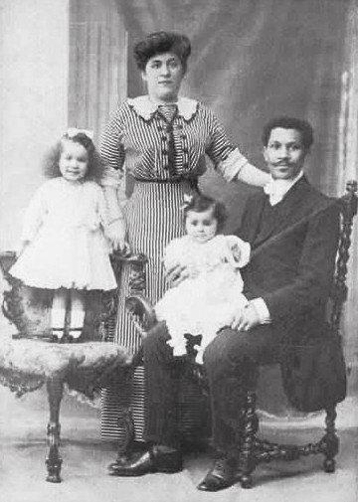
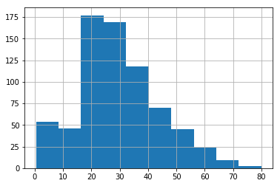

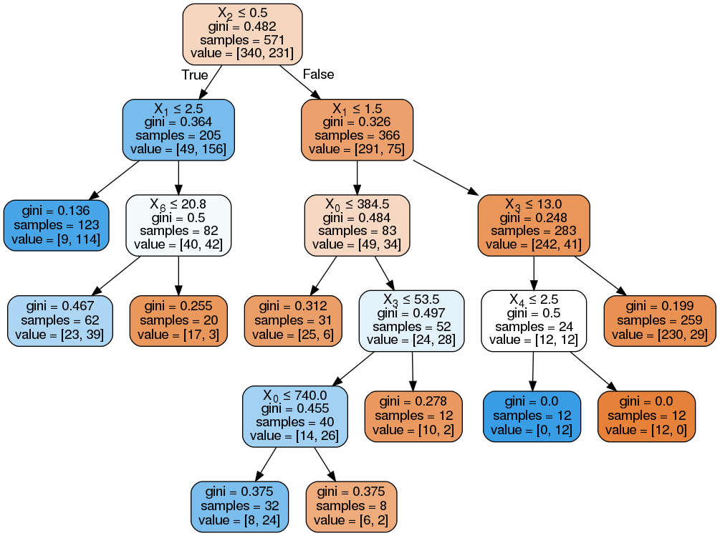

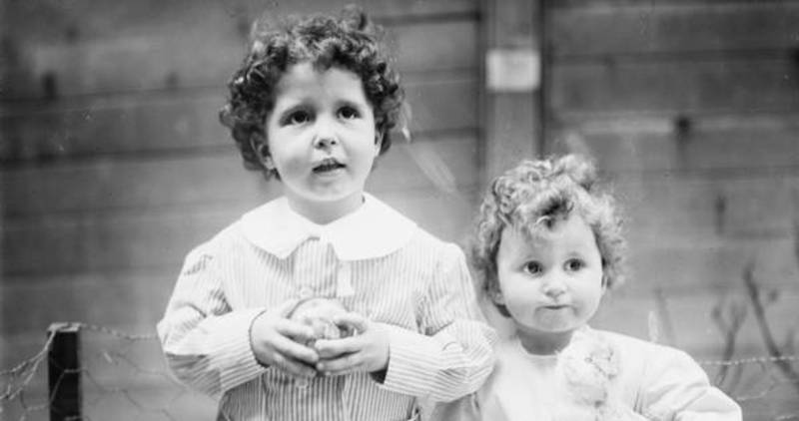
So, what will we do? - Learning from Disaster
Import & clean data
Understand data
Select Features
Train model
Evaluate model
PassengerId,Survived
892,0
893,0
894,0
895,0
896,1
897,1
Unknown data
Predict unknown cases
https://www.encyclopedia-titanica.org/

Slide 23
Lets Go !

Slide 24
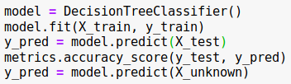

The actual machine Learning part
scikit-learn.org

Slide 25
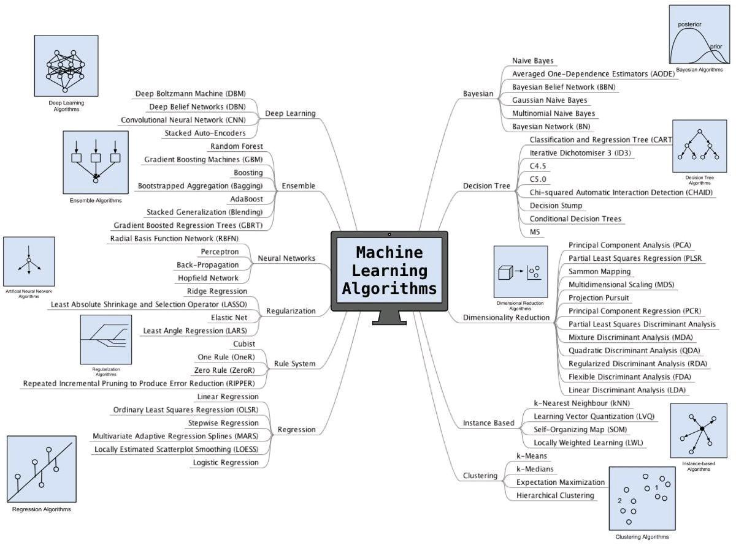
Decision trees are just one way to learn

Slide 26
What is important for ML ?

Slide 27
What is important for ML ?
Data driven
Density, diversity, structure

Slide 28
What is important for ML ?
Data driven
Density, diversity, structure
Problem definition
Supervised, unsupervised, reinforcement learning

Slide 29
What is important for ML ?
Data driven
Density, diversity, structure
Problem definition
Supervised, unsupervised, reinforcement learning
Model choice
Decision tree, deep neural networks, support vector machines...

Slide 30
What is important for ML ?
Data driven
Density, diversity, structure
Problem definition
Supervised, unsupervised, reinforcement learning
Model choice
Decision tree, deep neural networks, support vector machines...
Metrics to evaluate the model
Prediction score, prevention of overfitting

Slide 31
What is important for ML ?
Data driven
Density, diversity, structure
Problem definition
Supervised, unsupervised, reinforcement learning
Model choice
Decision tree, deep neural networks, support vector machines...
Metrics to evaluate the model
Prediction score, prevention of overfitting
Feature selection
Relevance, correlations

Slide 32
What is important for ML ?
Data driven
Density, diversity, structure
Problem definition
Supervised, unsupervised, reinforcement learning
Model choice
Decision tree, deep neural networks, support vector machines...
Metrics to evaluate the model
Prediction score, prevention of overfitting
Feature selection
Relevance, correlations
Iteration & architecture
Implementation, backup

Slide 33
What you learned today:

Slide 34
What you learned today:
Types of learning:
supervised, unsupervised, reinforcement

Slide 35
What you learned today:
Types of learning:
supervised, unsupervised, reinforcement
One machine learning model:
Decision trees

Slide 36
What you learned today:
Types of learning:
supervised, unsupervised, reinforcement
One machine learning model:
Decision trees
Data is the key component
Clean up is 80 % of the work

Slide 37
What you learned today:
Types of learning:
supervised, unsupervised, reinforcement
One machine learning model:
Decision trees
Data is the key component
Clean up is 80 % of the work
Implementation
Python, jupyter, Scikit learn

Slide 38
Buzzword BIngo :
Artificial Intelligence- AI
Machine Learning - ML
Artificial Neural Network
Cloud AI
Data Mining
Deep Learning - DL
BIG data
DNN
ANN
AIOps - automated DevOps
CNN
Data driven
Tensorflow
Keras
Artificial Neocortex
AI in IoT

Slide 39
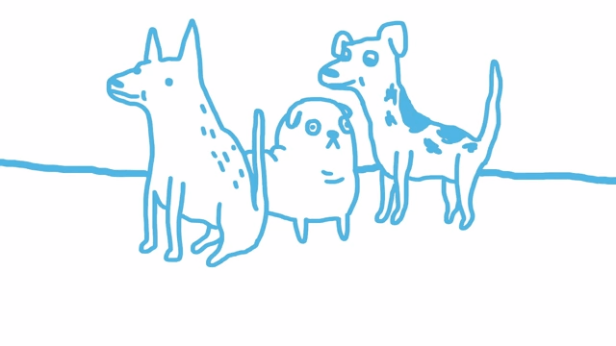
Questions ?

Slide 42
Gini Impurity
Gini impurity is the expected error rate if one of the results from a set is randomly applied to one of the items in the set.
If every item in the set is in the same category, the guess will always be correct, so the error rate is 0. If there are four possible results evenly divided in the group, there’s a 75 percent chance that the guess would be incorrect, so the error rate is 0.75.
This function calculates the probability of each possible outcome by dividing the number of times that outcome occurs by the total number of rows in the set. It then adds up the products of all these probabilities. This gives the overall chance that a row would be randomly assigned to the wrong outcome.
The higher this probability, the worse the split. A probability of zero is great because it tells you that everything is already in the right set.
https://github.com/ShawnLeee/the-book/blob/master/pybooks/Programming%20Collective%20Intelligence.pdf

Slide 43
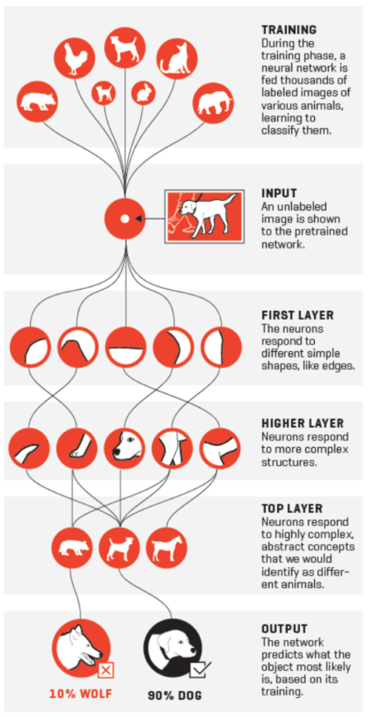
Artificial Neural Networks
https://www.widerfunnel.com/artificial-intelligence-in-marketing/

